Slide 1
FOSfor- Code-A-Thon backend Solution
Sahana S
Email-sahana.sathish96@gmail.com
Github repo https://github.com/sahanasatish143/wuelev8-movie-booking-system.git

Slide 2
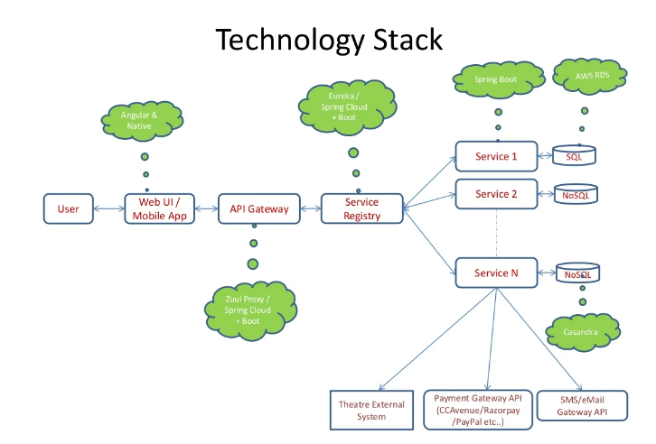

Slide 3
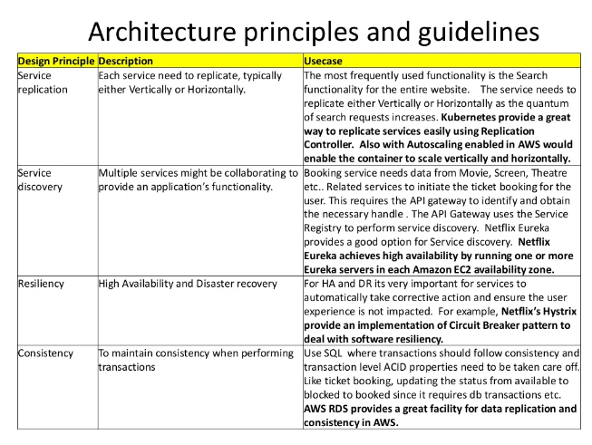

Slide 4
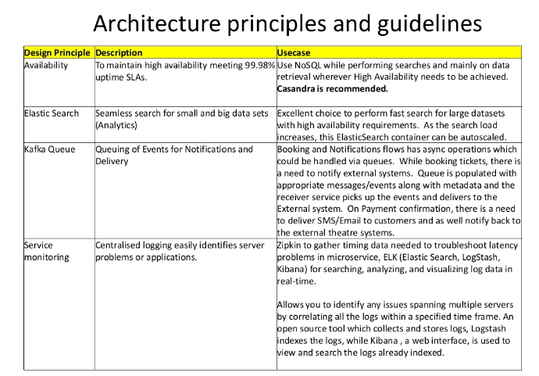

Slide 5
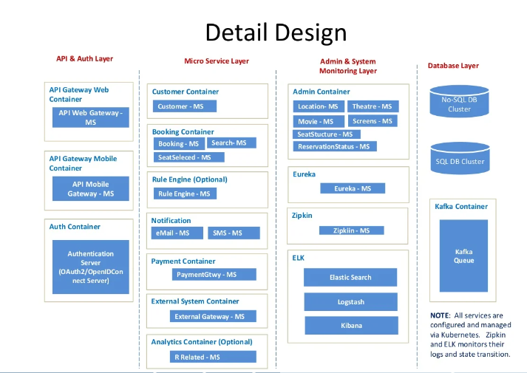
Architecture Diagram

Slide 6
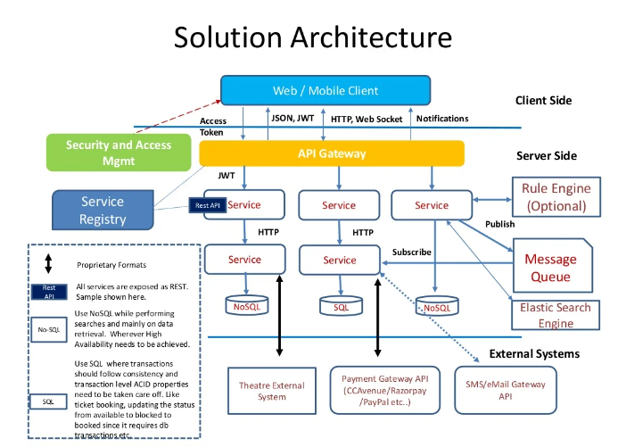

Slide 7
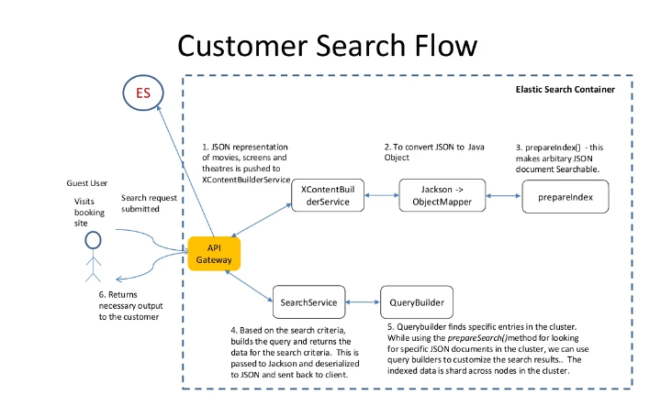

Slide 8
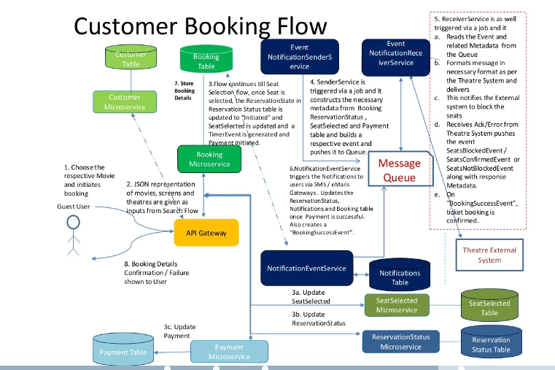

Slide 9
Thank You

